Slide 1

ASTOR AI
CHATBOT FOR MEDICAL QUERIES
PRESENTATION BY GROUP 33

Slide 2
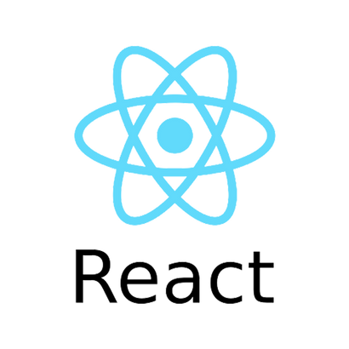




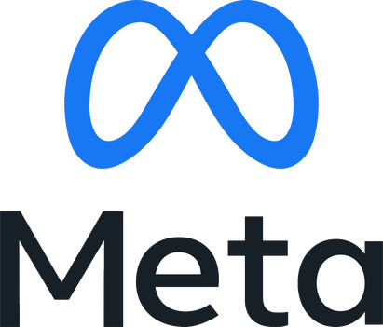
PROBLEM STATEMENT
Leveraging pre-trained LLMs like Mistral-7B for developing a Medical Chat Doctor can significantly enhance healthcare access by addressing patient queries, especially for non-critical conditions. Fine-tuning the model with custom medical data ensures accurate and relevant responses. This chatbot allows patients to input symptoms and receive concise, reliable answers, facilitating better diagnosis and care.
TECH STACK

Slide 3
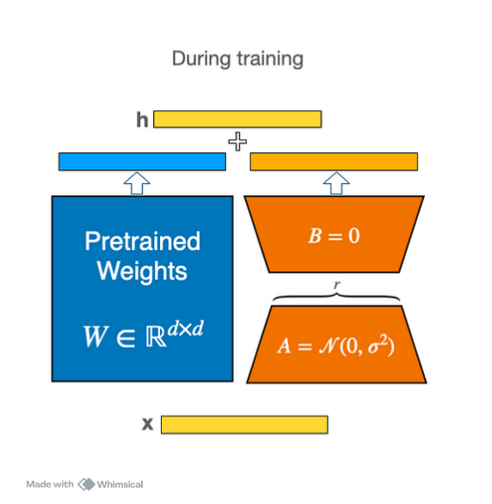
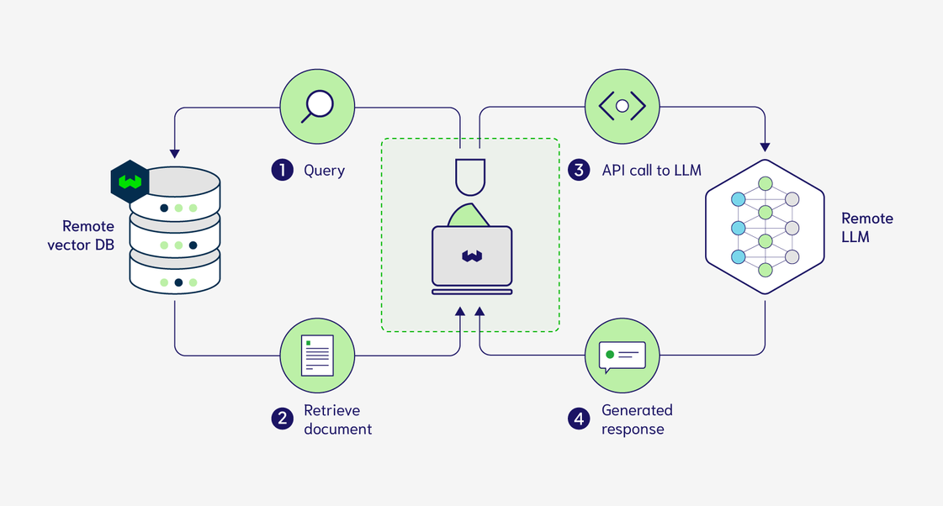
FINE-TUNING & RAG

Slide 4
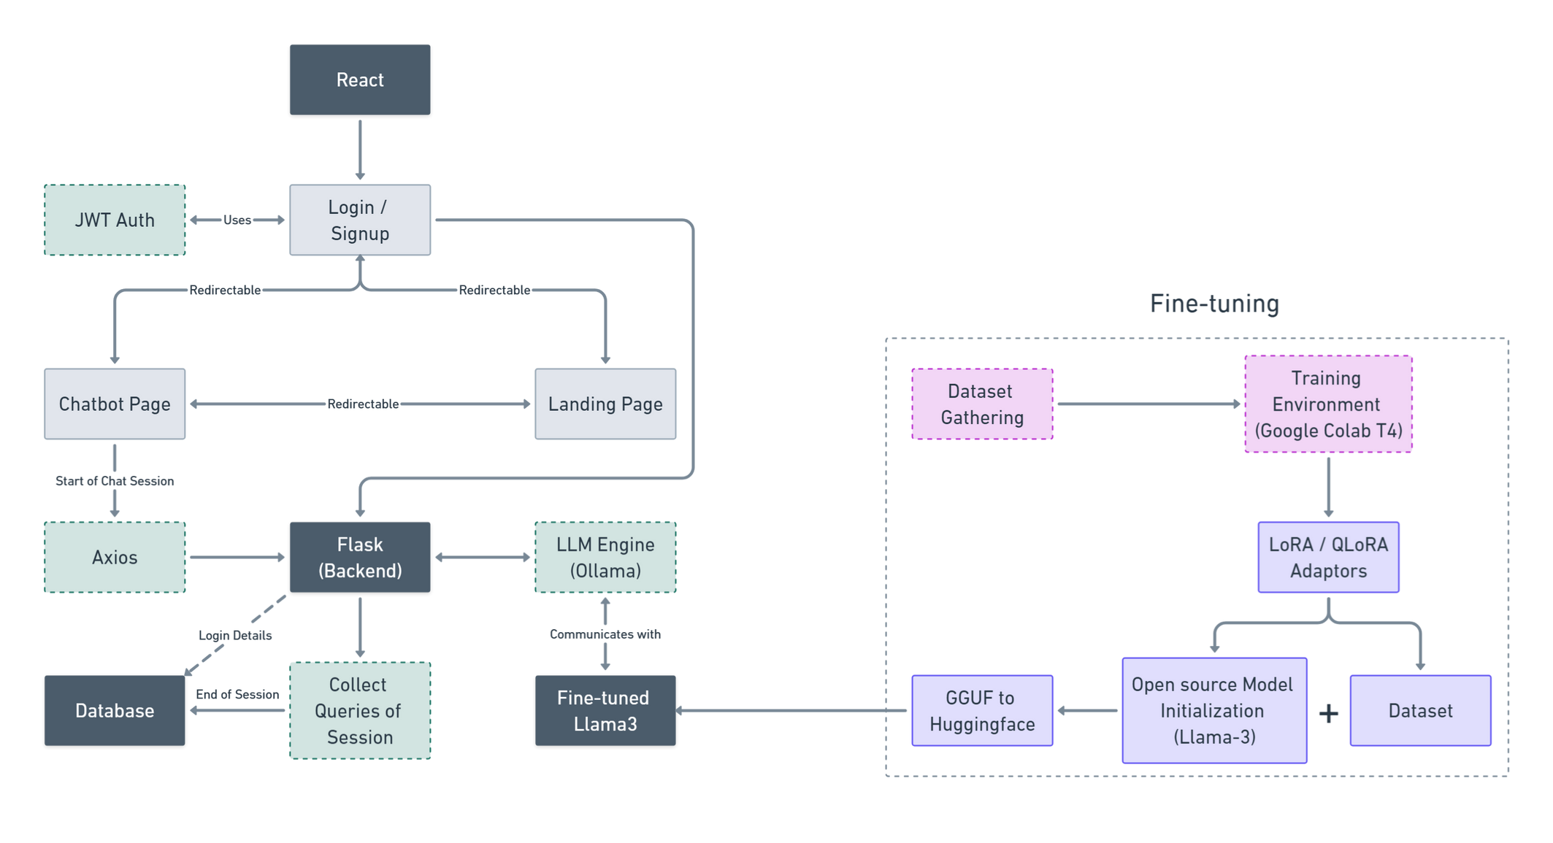
ARCHITECTURE

Slide 5
THANK YOU

